Slide 1
E-Commerce Data
Tomeh Lara (407)
Yasmin AL Othmani (411)
Alexandru Ștefan Ghiță (407)
Radu Puținelu (407)

Slide 2
Context
We live in the world of e-commerce. We see tons of different stores here and there through the web. Internet made it possible to trade with anyone and everywhere. We can buy goods without leaving our house, we can compare prices in different stores within seconds, we can find what we really want and do not accept just the first more or less suitable offer. And I believe it would be really interesting to look at this world through the data it produces. That's why I decided to play around with e-commerce numbers and try to understand it better.

Slide 3
Dataset
This is a transnational data set which contains all the transactions occurring between 01/12/2010 and 09/12/2011 for a UK-based and registered non-store online retail.The company mainly sells unique all-occasion gifts. Many customers of the company are wholesalers.

Slide 4
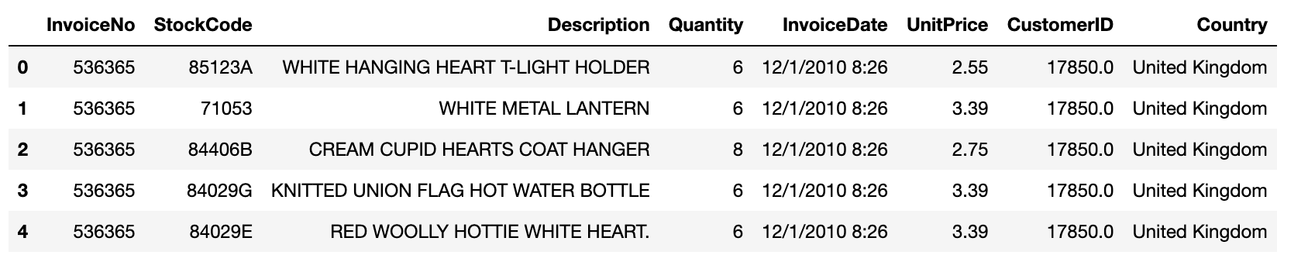
Dataset
Just by looking at first 5 rows of our table we can understand the structure and datatypes present in our dataset. We can notice that we will have to deal with timeseries data, integers and floats, categorical and text data.

Slide 5
EDA
Every data science project starts with EDA as we have to understand what do we have to deal with. We divide EDA into 2 types: visual and numerical. Let's start with numerical as the simple pndas method *.describe()* gives us a lot of useful information.

Slide 6
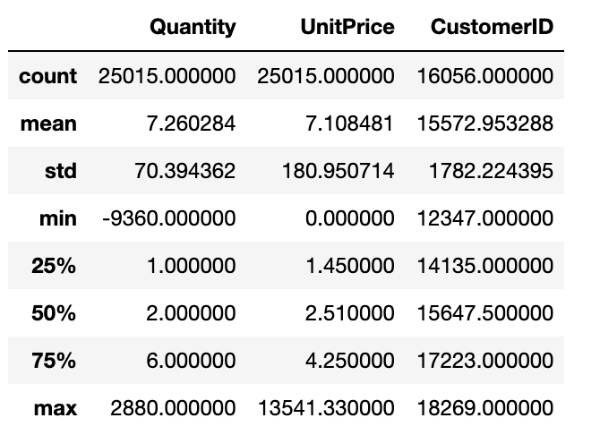
Quick statistical overview
Just a quick look at data with .describe() method gives us a lot of space to think. We see negative quantities and prices, we can see that not all records have CustomerID data, we can also see that the majority of transactions are for quantities from 3 to 10 items, majority of items have price up to 5 pounds and that we have a bunch of huge outliers we will have to deal with later.

Slide 7
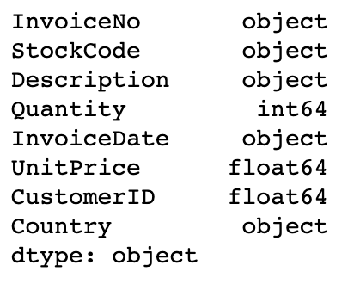
Dealing with types
.read_csv() method performs basic type check, but it doesn't do that perfectly. That's why it is much better to deal with data types in our dataframe before any modifications to prevent additional difficulties. Every pandas dataframe has an attribute .dtypes which will help us understand what we currently have and what data has to be casted to correct types.

Slide 8
Dealing with null values
Next and very important step is dealing with missing values. Normally if you encounter null values in the dataset you have to understand nature of those null values and possible impact they could have on the model. There are few strategies that we can use to fix our issue with null values:
delete rows with null values
delete the feature with null values
impute data with mean or median values or use another imputing strategy (method .fillna())

Slide 9
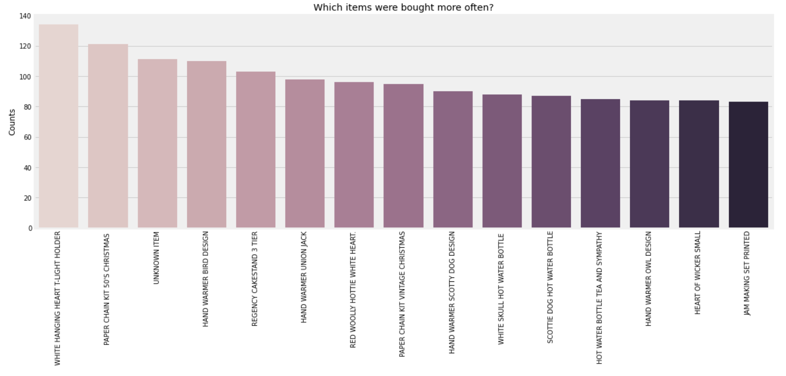
Checking out columns separately

Slide 10
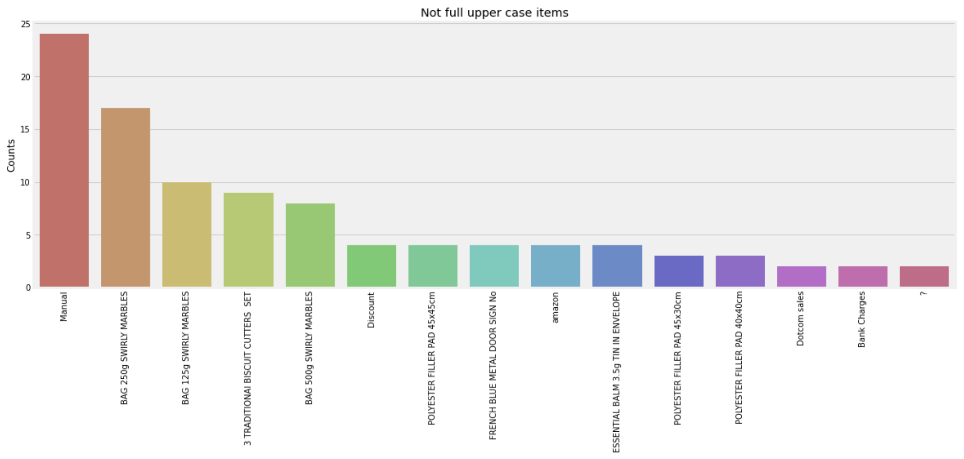
Checking out columns separately

Slide 11
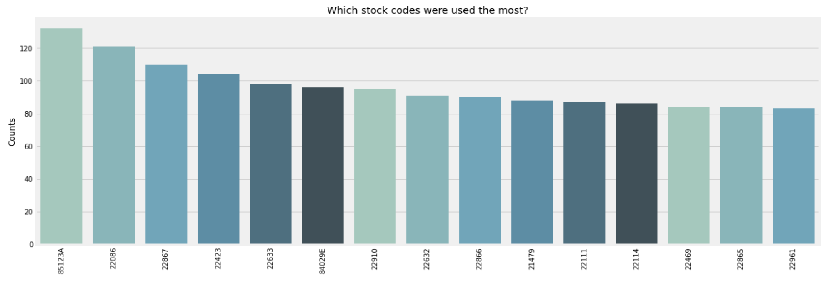
Checking out columns separately

Slide 12
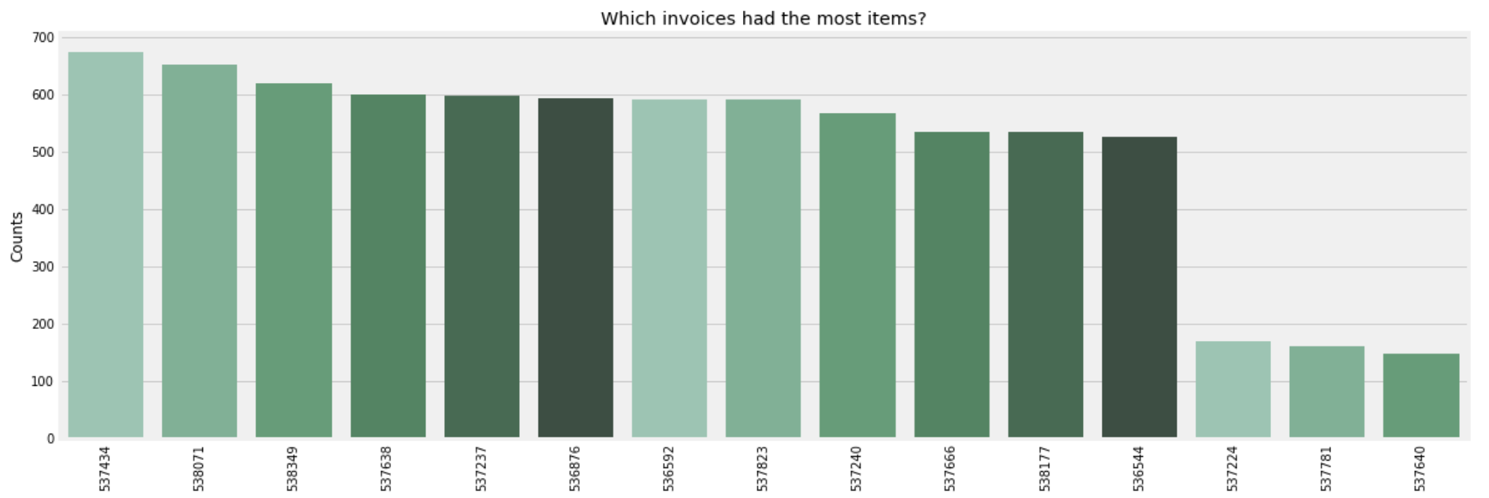
Checking out columns separately

Slide 13
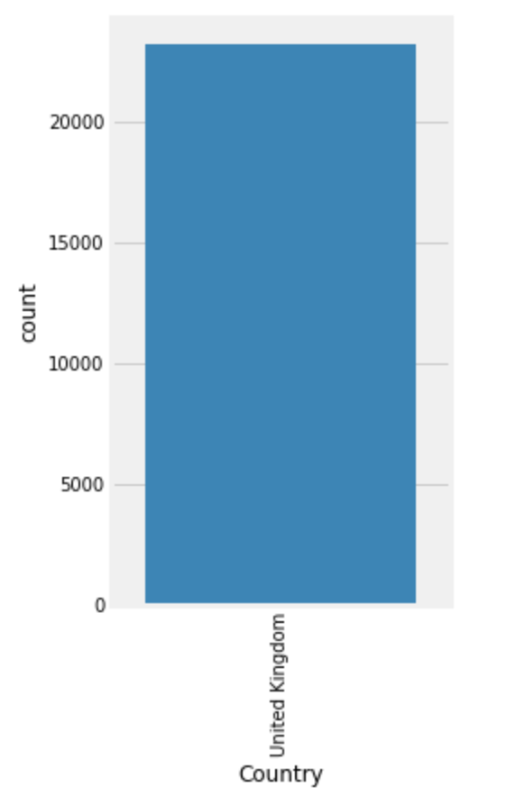
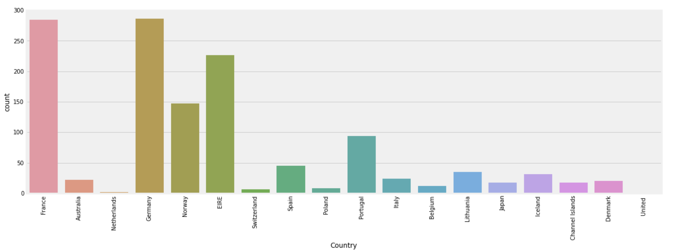
Visual EDA

Slide 14
Visual EDA
From above plots and calculations we can see that vast majority of sales were made in UK and just 8.49% went abroad. We can say our dataset is skewed to the UK side.

Slide 15
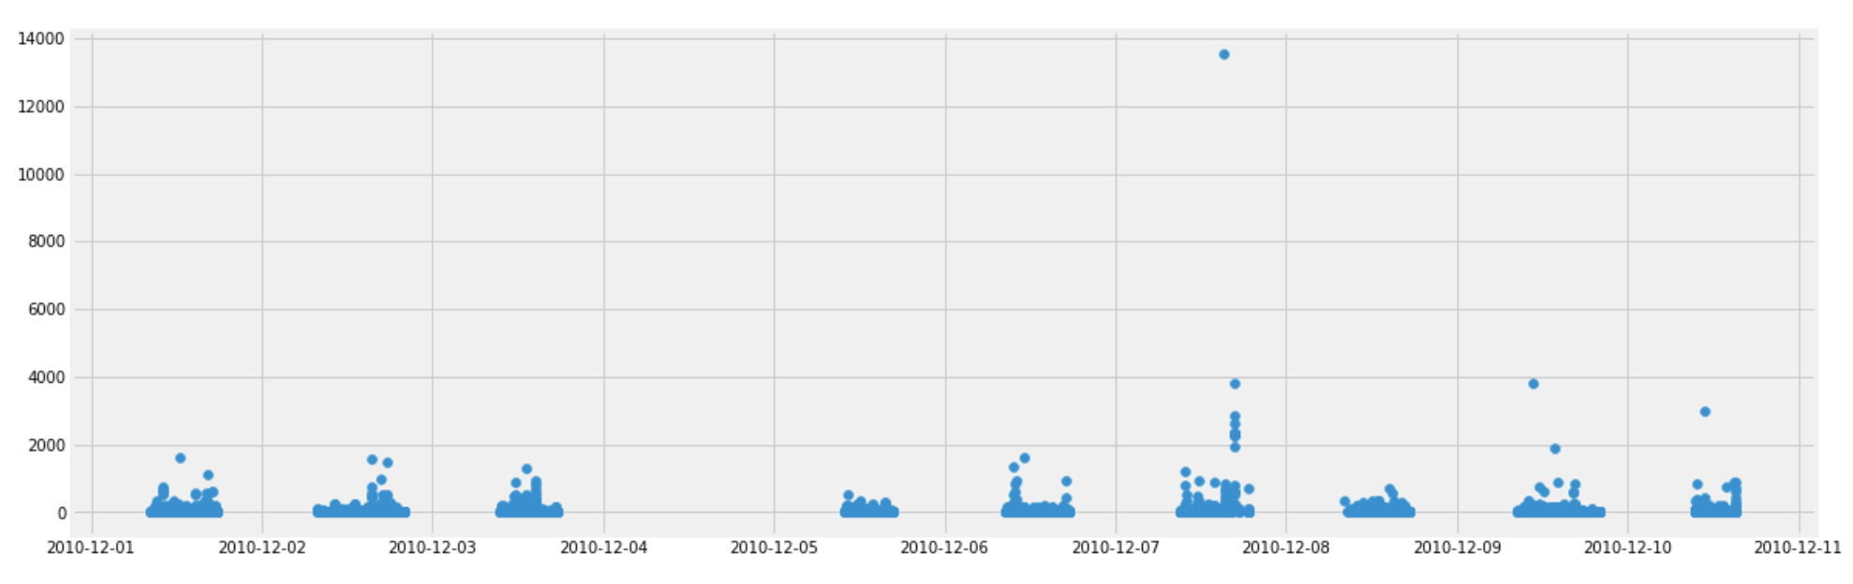
Detecting outliers

Slide 16
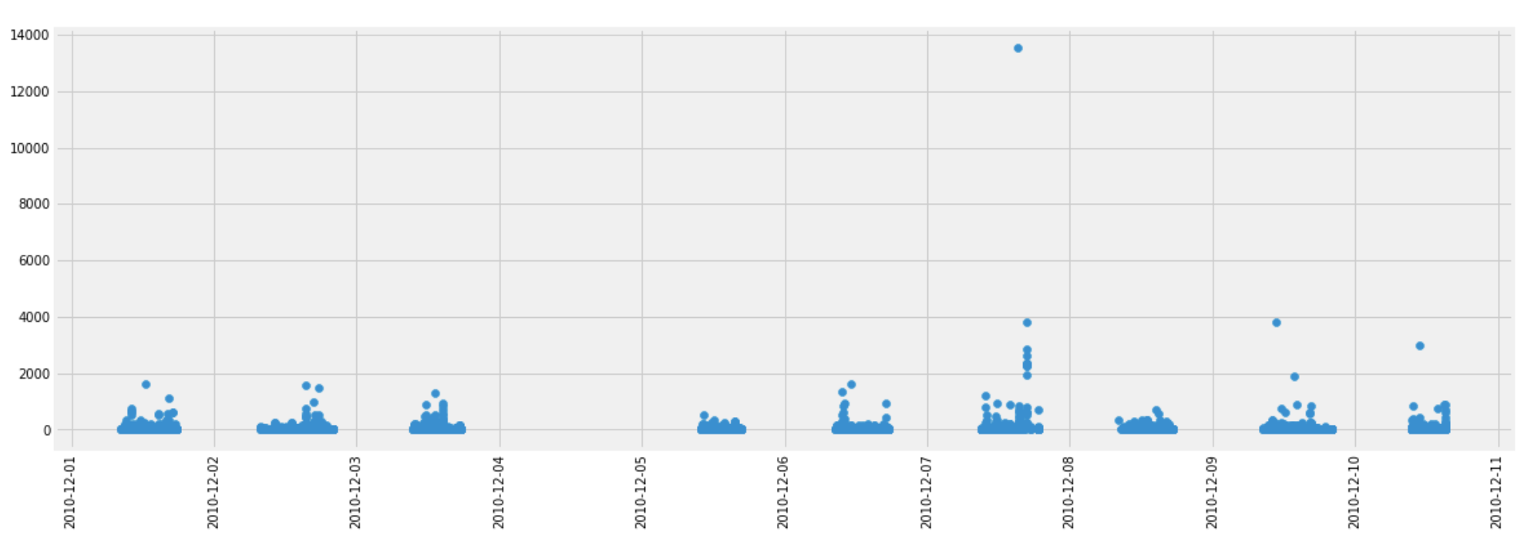
Detecting outliers
After removing obvious outliers we still see some values that are out of normal distribution.

Slide 17
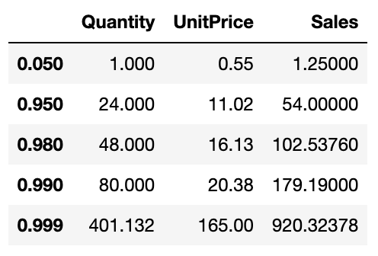
Detecting outliers
To understand better the distribution of our data let's check out different percentiles of our numeric features.
We can see that if we remove top 2% of our data points we will get rid of absolute outliers and will have more balanced dataset.

Slide 18
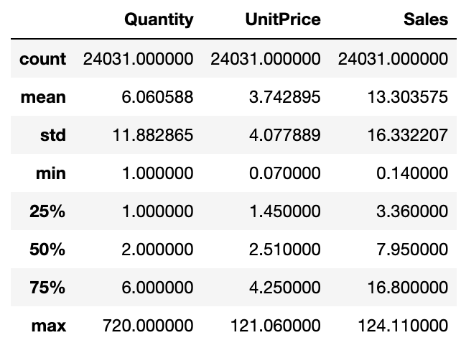
Ready
Looks like our data is almost ready for modelling. We performed a clean up, we removed outliers that were disturbing the balance of our dataset, we removed invalid records - now our data looks much better! and it doesn't lose it's value.

Slide 19
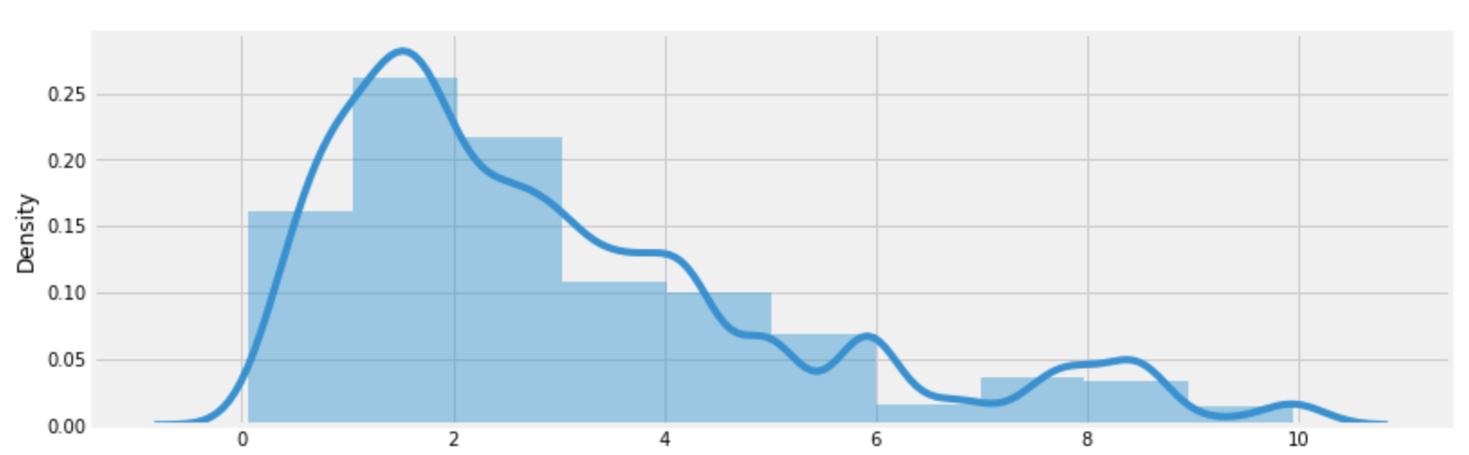
Visually checking distribution of numeric features

Slide 20
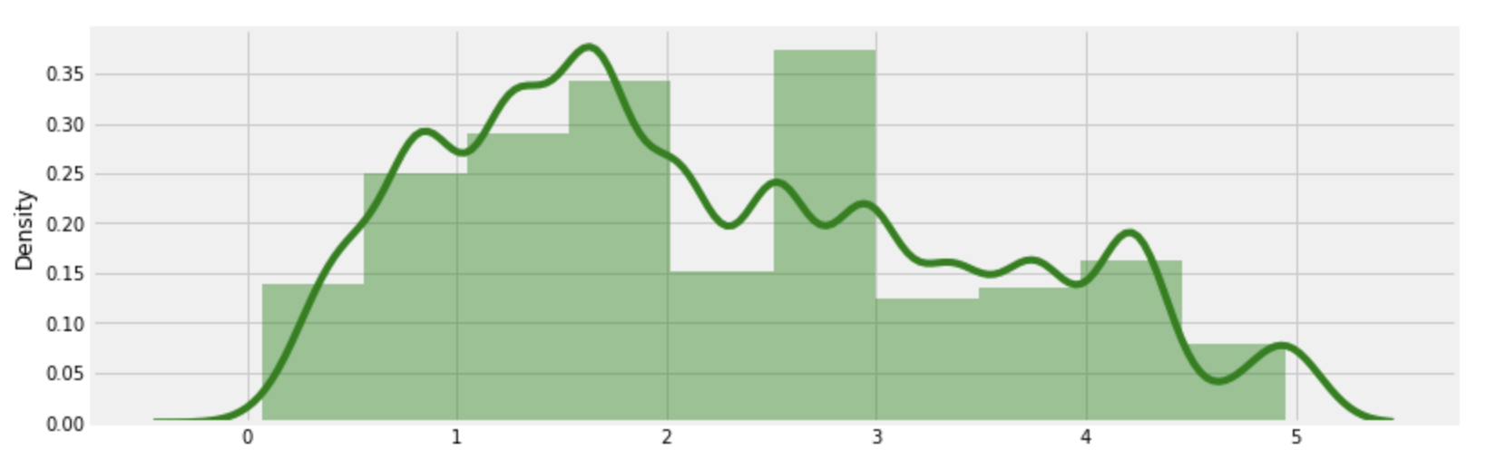
Visually checking distribution of numeric features

Slide 21
Visually checking distribution of numeric features
From these two histograms we can see that vast majority of items sold in this store has low price range - 0 to 3 pounds.

Slide 22
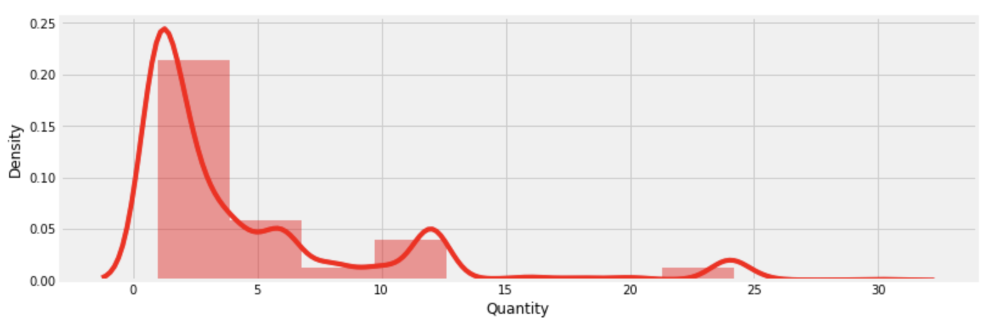
Visually checking distribution of numeric features

Slide 23
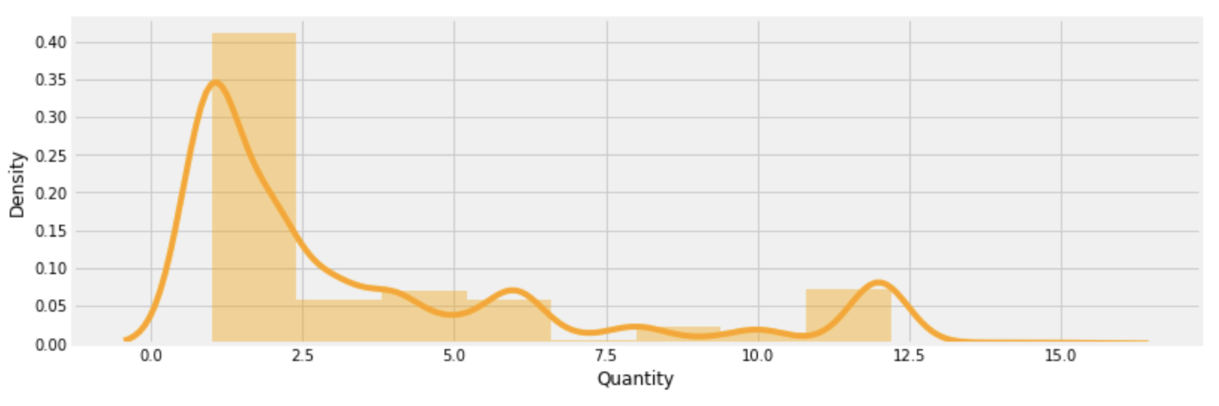
Visually checking distribution of numeric features

Slide 24
Visually checking distribution of numeric features
From these two histograms we that people bought normally 1-5 items or 10-12 - maybe there were some kind of offers for sets?

Slide 25
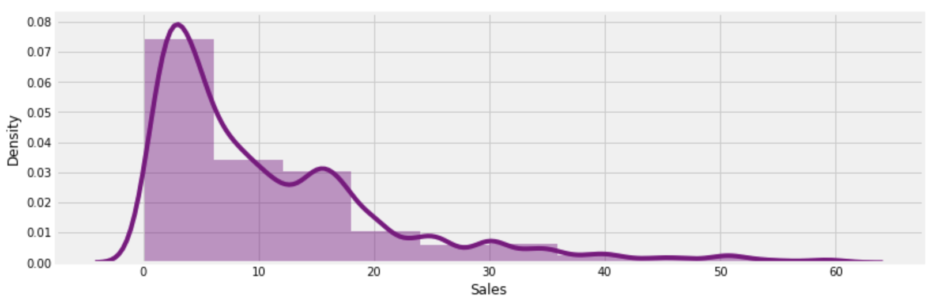
Visually checking distribution of numeric features

Slide 26
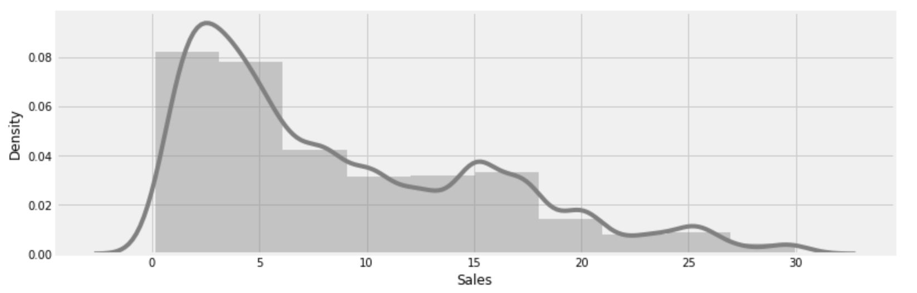
Visually checking distribution of numeric features

Slide 27
Visually checking distribution of numeric features
From these histograms we can understand that majority of sales per order were in range 1-15 pounds each.

Slide 28
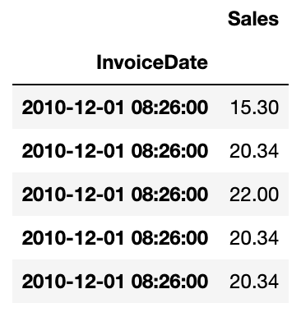
Analysing sales over time
As we can see every invoice has it's own timestamp (definitely based on time the order was made). We can resample time data by, for example weeks, and try see if there is any patterns in our sales.

Slide 29
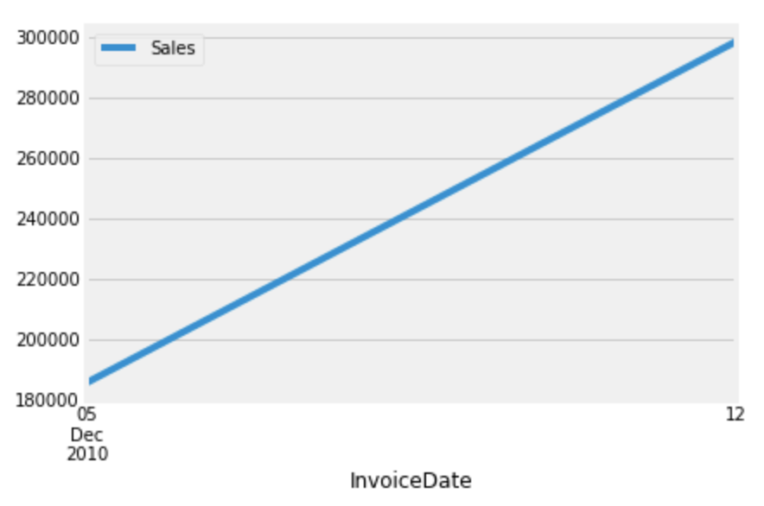
Analysing sales over time
That week with 0 sales in January looks suspicious, let's check it closer

Slide 30
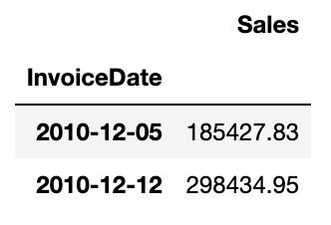
Analysing sales over time
Now it makes sense - possibly, during the New Year holidays period the store was closed and didn't process orders, that's why they didn't make any sales.

Slide 31
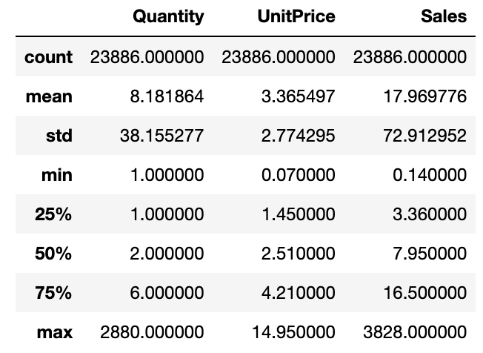
Preparing data for modeling and feature creation
Now it comes the most fun part of the project - building a model. To do this we will need to create few more additional features to make our model more sophisticated.

Slide 32
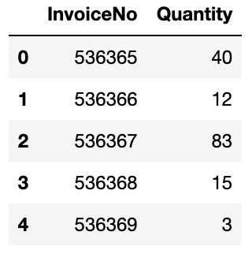
Quantity per invoice feature
A feature that could influence the sales output could be "Quantity per invoice". Let's find the data for this feature.

Slide 33
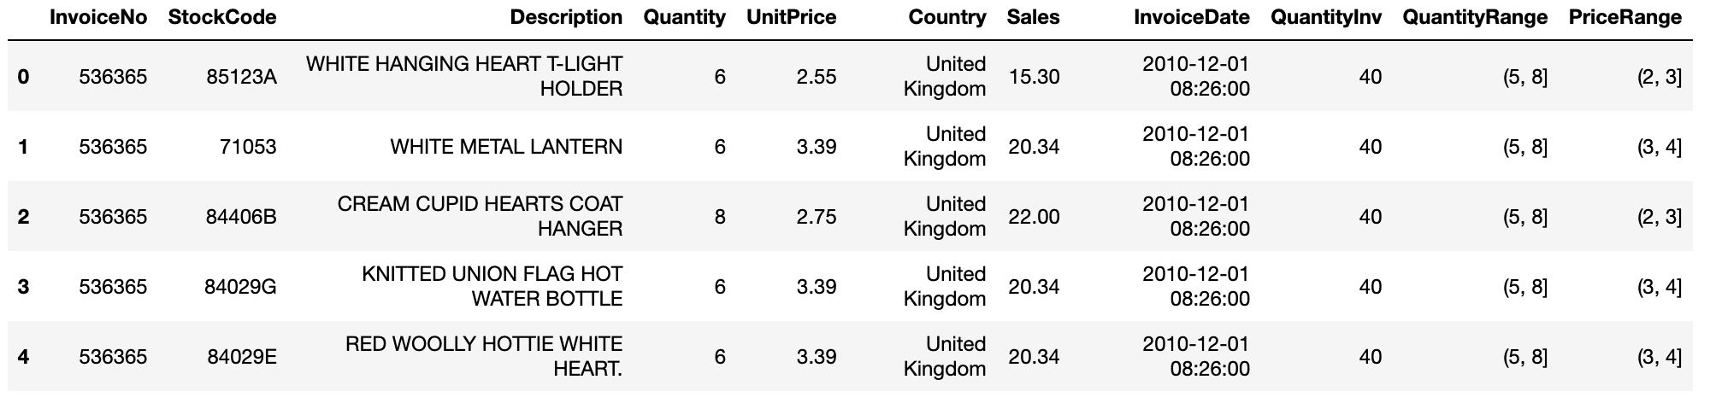
Bucketizing Quantity and UnitPrice features
Based on the EDA done previously we can group these features into 6 buckets for Quantity and 5 for UnitePrice using pandas .cut() method.

Slide 34
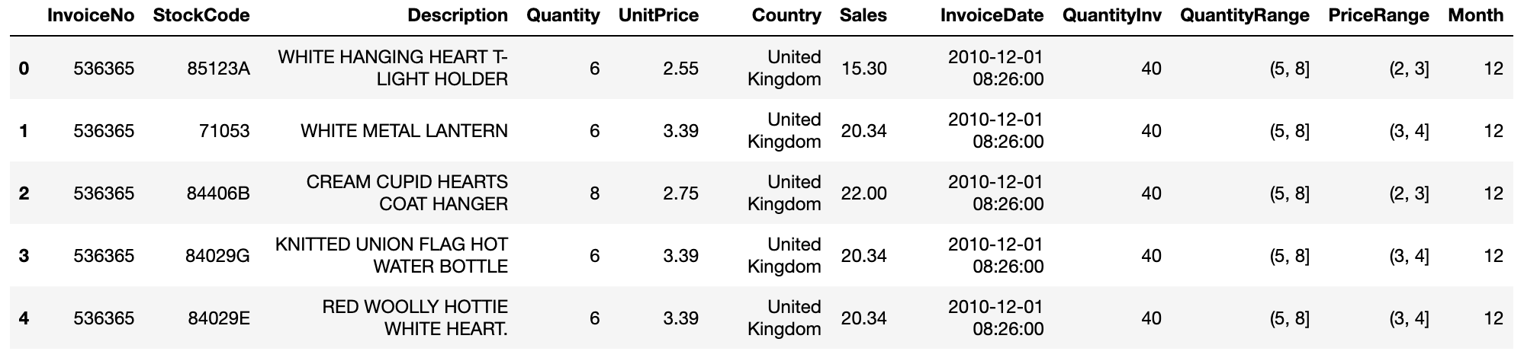
Extracting and bucketing dates
We have noticed that depends on a season gifts sell differently: pick of sales is in the Q4, then it drastically drops in Q1 of the next year and continues to grow till its new pick in Q4 again. From this observation we can create another feature that could improve our model.

Slide 35
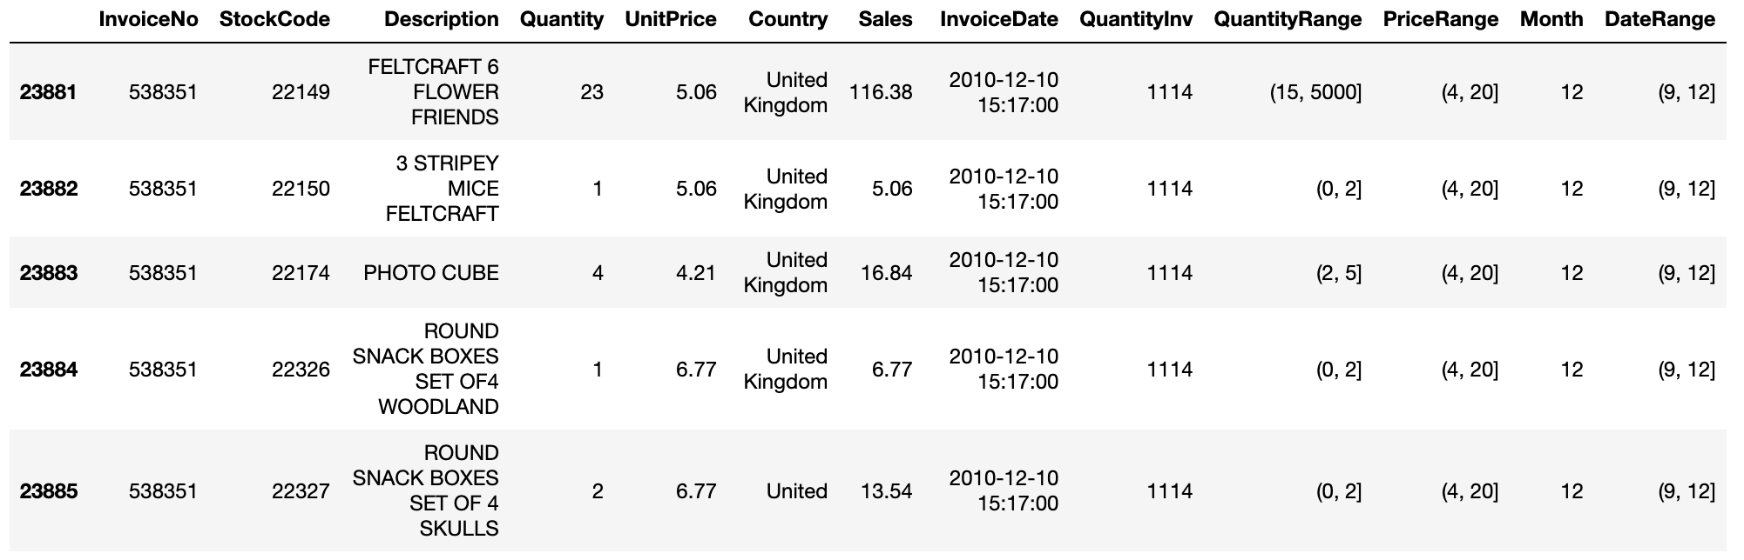
Extracting and bucketing dates

Slide 36
Building a model
Splitting data into UK and non-UK
We have to analyze these 2 datasets separately to have more standardized data for a model, because there can be some patterns that work for other countries and do not for UK or vise versa. Also a hypothesis to test - does the model built for UK performs good on data for other countries?

Slide 37
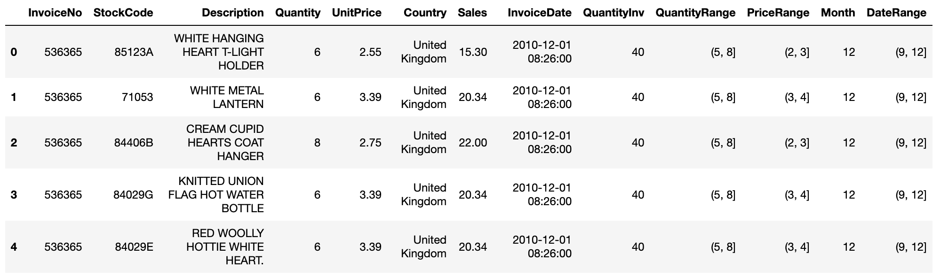
Building a model
Splitting data into UK and non-UK

Slide 38
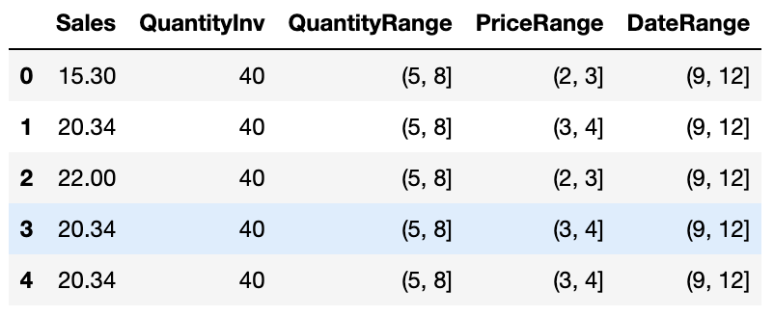
Extracting features and creating dummy variables

Slide 39
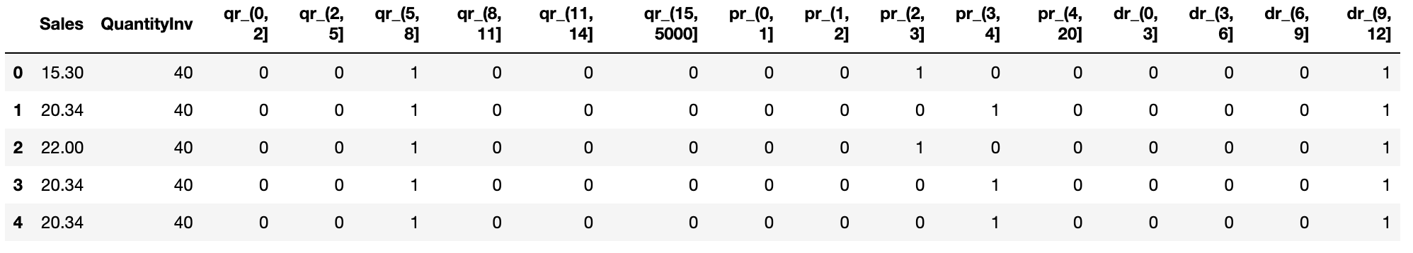
Extracting features and creating dummy variables

Slide 40
Scaling
As the majority of our features are in 0-1 range it would make sense to scale "QuantityInv" feature too. In general, scaling features is normally a good idea.

Slide 41
Accuracy of models
Model Name | Without applying dimension reduction | PCA | TruncatedSVD | T-SNE
LogisticRegression | 31.0 % | 31.0 % | 10.0 % | 9.0 %
KNeighborsClassifier | 33.0 % | 34.0 % | 30.0 % | 33.0 %
SVC | 32.0 % | 32.0 % | 9.0 % | 28.0 %
DecisionTreeClassifier | 36.0 % | 36.0 % | 35.0 % | 33.0 %

Slide 42
Thank you!

